Slide 1
Why are you “Awaiting”
to use Async!

Slide 2
Notes:
All right, let's get going here.
How we doing tonight?
Okay
So we begin,
With…
Hello…
It is very possible that
You may recognize me

Slide 3

Notes:
No, I’m not Anthony Edwards…

Slide 4

Notes:
Nor am I Brian Poeshen.

Slide 5

Notes:
And I’m not…
No, wait, that is me.
Long story.
Anyways,

Slide 6




Glen R. Goodwin
@areinet
arei.net
github.com/arei
Notes:
Here I am.
You might know me from here at CharmCityJS
Or NodeSchool
Or from around the community.
But if you don’t…
these are my places…
<pause>
and I work for this company

Slide 7

Notes:
The Awesome Engineering Company.
Which makes libraries and enterprise applications
In nodejs for handling massive scale.
I'll hit you with a sales pitch in a few minutes.
But for now I'm here to talk to you about

Slide 8
Why are you “Awaiting”
to use Async!
Notes:
Why Are You "Awaiting" to use Async!
(Something about this font makes me want to modulate my tone
Make it sound more baritone, more grandious!
So yea, today we are talking about async/await…
BUT!

Slide 9

The HISTORY of JAVASCRIPT
Notes:
In order to talk to you about Async/Await
we first need to revisit the history of JavaScript.
And I'm sure many of you have heard this before,
so I will try to be quick.

Slide 10

Notes:
1993 we get the first graphical browser NCSA Mosaic

Slide 11

Notes:
1994 we get the first commercial browser, Mosaic Netscape 0.9

Slide 12
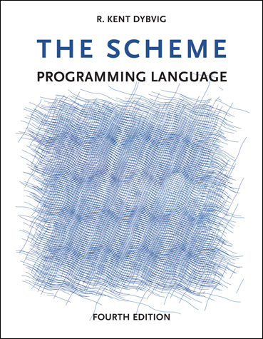
Notes:
1995 Netscape realizes that HTML needs a "glue language".
They hire Brendan Eich to implement the Scheme Programming Language for their Browser.
Yes, the initial plan was to have Scheme which derives from LISP as the scripting language of the browser.
If you want to learn how far computer languages have come, go read about LISP some time.
But just as Eich was coming on board,

Slide 13

Notes:
Netscape signed an agreement with Sun Microsystems,
Who invented and owned the Java Programming language
to provide Java in browsers.
And thus the dark age of java applets was born.
But Netscape realizes that despite Java Applets,
We still need a “glue language” for HTML.
So…

Slide 14


+
=
Notes:
In May of 1995 Eich writes JavaScript in 10 days.
It borrows Java's syntax.
But it also borrows some very interesting features from Scheme.

Slide 15
x = 123
x
f
f = function() {
…
}
y
y = “hello”
Notes:
In particular, Scheme stores functions and variables
in the same reference lookup table.
Meaning a variable can be a reference to a function.
Until JavaScript this had largely not been done.
What this means is that functions are variables.
And they can be passed
as arguments to other functions
and called within those functions.
Thus the JavaScript Callback was born.

Slide 16
on(“click”,function(){
… do something …
});
Notes:
And its gets used pretty much right away in the browser
for event handling and the like.
In 1998, we get our first AJAX/XMLHttpRequest efforts.
And thus begins the slightly less dark age known as "Callback Hell"

Slide 17

doSomething(function(){
});
CALLBACK HELL
Notes:
Wherein one function
calls a function with a callback
which in turn calls a function with a callback

Slide 18
doSomething(function(){
andThis(function(){
andDontForgetThis(function(){
andTomWantedThis(function(){
gottaMakeItSecure(function(){
butMarketingNeedsItThisWay(function(){
turnItGreen(function(){
console.log(“Umm….”);
});
});
});
});
});
});
});
CALLBACK HELL
Notes:
which in turn calls a function with a callback
which in turn calls a function with a callback
which in turn calls a function with a callback
which in turn calls a function with a callback
which in turn calls a function with a callback
A lot of people find this frustrating
And a bunch of these people come up with the idea
to add the notion of a Promise to JavaScript.

Slide 19

A Promise represents an operation to be completed in the future.
Notes:
A Promise represents an operation to be completed in the future.
this is sometimes called a Future or Deferred in other languages
And is not unique to javascript.
Promises are callbacks taken up a notch.
But its important to know that promises
Are built on callbacks and
underneath a promise is just callback magic.

Slide 20

Notes:
2012ish We see the first Promise specifications
Promises/A and B and C and D and eventually A+
Which is what our current spec is based on.

Slide 21
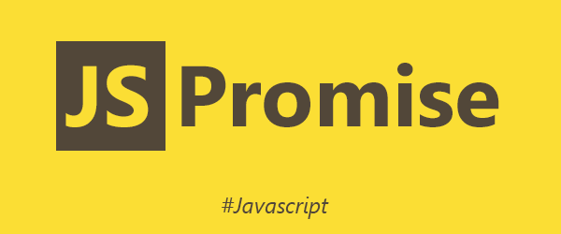
Notes:
June 2015 Promise Formally Added to JavaScript.
And everyone can start using them!
Hooray!
And thus begins the medium gray age called Promise Purgatory(tm).

Slide 22

doSomething()
.then(function(){
});
PROMISE PURGATORY
™
Notes:
Wherein one promise
chains another promise

Slide 23
doSomething()
.then(function(){
})
.then(function(){
})
.then(function(){
})
.then(function(){
})
.then(function(){
})
.then(function(){
})
.then(function(){
});
PROMISE PURGATORY
™
Notes:
then another promise
then another promise
then another promise
then another promise
then another promise
then another promise
But the people who came up with Promises
Knew this was going to happen…
But they also knew that it wasn't really about promises.
Promises were a stepping stone.
To something better.

Slide 24
async/await
Notes:
Async/await
But first…

Slide 25

Notes:
A KITTEN!
This is our brand new kitten Zephyr.
He is so cute!
<pause>
And now that I've pulled you in with a kitten, a commercial!

Slide 26
commercial
Notes:
In July of this year,
I quit my job
And started
The Awesome Engineering Company.

Slide 27
Notes:
My first goal at Awesome Engineering
Is to come up with stable, secure, robust tooling
for building enterprise applications with nodejs.
Tooling that is free from external dependencies,
Tooling that is designed with scale in mind,
Tooling that is architected to be cohesive and work together.
In the coming months
I will be sharing some of what I have been building.
And I hope that all of you will help me out.
By taking my stuff for a test drive.
Kicking the tires, Filling a bug or two,
Or just generally talking with me about the enterprise problems you see with nodejs.
And If you are interested you can checkout my initial work right now at

Slide 28
github.com/awesomeeng
npmjs.com/org/awesomeeng
Notes:
Github and/or npm.
<TAKE PAUSE>
Okay.
Commercial over.
Now back to…

Slide 29
async/await
Notes:
Async/Await

Slide 30
async function HelloWorld() {
console.log("hello");
await sleep(1000);
console.log("world");
};
Notes:
The purpose of Async/Await is to make javascript...
wait...
for a promise to resolve or reject.
That's it.
Nothing complicated.
But its so much more than that!
ONE

Slide 31
1
async function HelloWorld() {
console.log("hello");
await sleep(1000);
console.log("world");
};
Notes:
using await means no more then() methods.
TWO

Slide 32
2
async function HelloWorld() {
console.log("hello");
await sleep(1000);
console.log("world");
};
Notes:
TWO
values returned from the promise, are just returned from the await.
THREE

Slide 33
3
async function HelloWorld() {
console.log("hello");
await sleep(1000);
console.log("world");
};
Notes:
when a promise rejects, it just becomes a thrown error!
That you can catch!
With a try/catch block.
No more catch() methods!
FOUR

Slide 34
4
async function HelloWorld() {
console.log("hello");
await sleep(1000);
console.log("world");
};
Notes:
async/await is fundamentally cleaner to read.
The flow is inherent in the code.
FIVE

Slide 35

Notes:
A KITTEN!
How can you say no to him?
So, now that you’ve had a second kitten,
Let take a look at how we use async/await.

Slide 36
BASIC EXAMPLE
Notes:
Here is a basic example:

Slide 37
BASIC EXAMPLE
Sleep =>
wait for n milliseconds
return
Notes:
Say we have a function, sleep,
which returns a promise
that resolves after n milliseconds.

Slide 38
BASIC EXAMPLE
Sleep =>
wait for n milliseconds
return
HelloWorld =>
print “hello”
sleep 1000ms
print “world”
Notes:
Next, we have a HelloWorld function
Which we want to print out "hello",
wait 1000ms,
and then print out "world".

Slide 39
BASIC EXAMPLE
CALLBACK
function sleep(ms,done) {
setTimeout(()=>{
done();
}, ms);
};
function HelloWorld() {
console.log("hello");
sleep(1000,()=>{
console.log("world");
});
};
HelloWorld();
Notes:
With callbacks, our code would look like this:
Sleep takes two arguments,
the number of milliseconds to sleep
and the callback function to execute when done.
Our HelloWorld function,
prints out "hello",
calls sleep with 1000 and the function to run when done
which after 1000ms executes.
and prints out "world".

Slide 40
BASIC EXAMPLE
CALLBACK
PROMISE
function sleep(ms,done) {
setTimeout(()=>{
done();
}, ms);
};
function HelloWorld() {
console.log("hello");
sleep(1000,()=>{
console.log("world");
});
};
HelloWorld();
function sleep(ms) {
return new Promise(
(resolve,reject)=>{
setTimeout(()=>{
resolve();
}, ms);
});
};
function HelloWorld() {
console.log("hello");
sleep(1000).then(()=>{
console.log("world");
});
};
HelloWorld();
Notes:
With promises, our code would look like this:
Sleep takes one argument,
the number of milliseconds to sleep,
and returns a promise.
The promise will resolve, after the given number of milliseconds has passed.
Our HelloWorld function,
prints out "hello",
calls sleep with 1000
and tells the returned promise what to execute next.
which after 1000ms executes.
then prints out "world".

Slide 41
BASIC EXAMPLE
CALLBACK
PROMISE
async/await
function sleep(ms,done) {
setTimeout(()=>{
done();
}, ms);
};
function HelloWorld() {
console.log("hello");
sleep(1000,()=>{
console.log("world");
});
};
HelloWorld();
function sleep(ms) {
return new Promise(
(resolve,reject)=>{
setTimeout(()=>{
resolve();
}, ms);
});
};
function HelloWorld() {
console.log("hello");
sleep(1000).then(()=>{
console.log("world");
});
};
HelloWorld();
function sleep(ms) {
return new Promise(
(resolve,reject)=>{
setTimeout(()=>{
resolve();
}, ms);
});
};
async function HelloWorld() {
console.log("hello");
await sleep(1000);
console.log("world");
};
HelloWorld();
Notes:
With async/await, our code would look like this:
Sleep is the same as the promise example before.
It takes one argument,
the number of milliseconds to sleep,
and returns a promise.
The promise will resolve, after the given number of milliseconds has passed.
Our HelloWorld function,
prints out "hello",
Calls sleep with 1000,
Sleep returns a promise.
Await pauses the execution until the promise resolves.
sleep resolves,
the await resumes,
and it prints out “world".
Comparing the three…

Slide 42
BASIC EXAMPLE
CALLBACK
PROMISE
async/await
function sleep(ms,done) {
setTimeout(()=>{
done();
}, ms);
};
function HelloWorld() {
console.log("hello");
sleep(1000,()=>{
console.log("world");
});
};
HelloWorld();
function sleep(ms) {
return new Promise(
(resolve,reject)=>{
setTimeout(()=>{
resolve();
}, ms);
});
};
function HelloWorld() {
console.log("hello");
sleep(1000).then(()=>{
console.log("world");
});
};
HelloWorld();
function sleep(ms) {
return new Promise(
(resolve,reject)=>{
setTimeout(()=>{
resolve();
}, ms);
});
};
async function HelloWorld() {
console.log("hello");
await sleep(1000);
console.log("world");
};
HelloWorld();
Notes:
We see that the sleep method,
is slightly more complicated in the promise and async/await versions
But the code for HelloWorld is much cleaner in the async/await version.
Also, in the callback and promise versions
our HelloWorld runs internal functions.
None of that is necessary in the async/await version.
Imagine if we wanted to call our sleep function twice in a row.
Or three times. Gets complicated with callbacks
A little better with promises
But with async/await it readily simple and apparent…
<pause>
Next, lets break async/await down a bit more to understand it better.

Slide 43
The async Keyword
async function HelloWorld() {
console.log("hello");
await sleep(1000);
console.log("world");
};
Notes:
First, in order to use await, we must first tell JavaScript to expect it.
this is done at the function level
by specifying that the function is an async function.
This creates a slightly different type of function than a function definition without the async keyword.
You can see this with a quick test in nodejs.

Slide 44
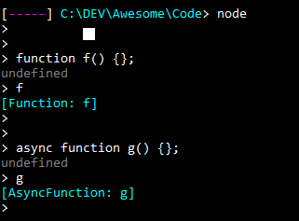
The async Keyword
async function HelloWorld() {
console.log("hello");
await sleep(1000);
console.log("world");
};
Notes:
an async function will execute like a standard function
until it hits an await statement.
At that point the async function execution will pause
until the awaited promise resolves
This pause doesn't block the main javascript thread,
So tasks waiting in the execution stack
will continue to run
while your async function is paused.
Once the promise resolves,
The await completes
And execution of the function continues.
<pause>
Now, once we have an async function, we can use await.

Slide 45
The await Keyword
async function HelloWorld() {
console.log("hello");
await sleep(1000);
console.log("world");
};
Notes:
The await keyword is used to tell an async function
that it should wait for the expression that follows to resolve.

Slide 46
The await Keyword
await square(4);
await 123;
await “concat” + “this” + “string”;
Notes:
await must be followed by an expression
as in "await square(4)" or "await some value".

Slide 47
The await Keyword
If this returns a promise, wait for the promise to resolve or reject.
await square(4);
await 123;
await “concat” + “this” + “string”;
Notes:
If the following expression results in a promise,
await will pause execution
until the promise resolves or rejects

Slide 48
The await Keyword
If this or these return anything else, wrap it in a Promise.resolve() and wait for it to resolve.
await square(4);
await 123;
await “concat” + “this” + “string”;
Notes:
If the evaluated expression does not result in a promise,
a value for example,
Like 123 here,
await will wrap the value in an immediately resolving promise
With Promise.resolve()
And wait for that to resolve.

Slide 49
The await Keyword
let x = await 123;
return await “concat” + “this” + “string”;
assert.equal(await square(4),16);
Notes:
Await is an expression in and of itself
And thus can be used anywhere an expression is used
Including assignments
Or returns
Or as arguments to other functions,
As shown here.
So that’s the basics of async/await…
But it wouldn’t be JavaScript if there weren’t a few side effects to know…

Slide 50
await on a promise
function multiply(x,y) {
return new Promise((resolve)=>{
setTimeout(()=>{
resolve(x*y);
},1000);
});
}
async function HelloWorld() {
console.log(“hello”);
console.log(“82 times 47 equals “+(await multiply(82,47)+”.”);
console.log(“world”);
}
HelloWorld();
Notes:
Generally if you await on a called function,
that function should return a promise.
Otherwise, the await may not pause as expected.
So get in the habit of only awaiting on things that return a promise.
Also, await doesn’t really save you from writing Promises,
They are still very, very much a part of async/await.
But it does save you from writing then() methods.

Slide 51
Catching a Rejection
function throwSomething(x,y) {
return new Promise((resolve,reject)=>{
reject(new Error(“something error.”));
});
}
async function HelloWorld() {
try {
await throwSomething();
}
catch (ex) {
console.error(ex);
}
}
HelloWorld();
Notes:
Also, one of the awesome features of async/await is that
promise rejections are just thrown as exceptions.
This means you can use a standard try/catch block
to handle the rejection you get back from your promise!
It is worth pointing out
you should always catch your await exceptions
or you end up with the dreaded UnhandledRejection exception
If you have used promises a lot,
you are all to familiar with this exception;
But, the good news is these are far easier to read
And to trace,
with async/await then just straight promises.

Slide 52
Iterating and Awaiting
function square(x) {
return x*x;
};
function map(a) {
return a.map((x)=>{
return square(x);
});
}
map([0,1,2,3,4,5,6,7,8,9]);
// returns [ 0, 1, 4, 9, 16, 25, 36, 49, 64, 81 ]
Notes:
Also, a special case comes up with async/await and iteration.
By and large we no longer really use for loops
for iterating over arrays anymore.
Instead we use Array methods
like forEach() and map() and filter() which take an iteration method
Like I’ve shown here.
However, if the iteration method needs to await ,
things dont quite work as expected.

Slide 53
Iterating and Awaiting
function square(x) {
return new Promise((resolve,reject)=>{
setTimeout(()=>{resolve(x*x);},250);
});
}
function map(a) {
return a.map(async (x,i)=>{
return await square(x);
});
}
map([0,1,2,3,4,5,6,7,8,9]);
// returns [ Promise { <pending> },Promise { <pending> },Promise { <pending> },Promise { <pending> },Promise { <pending> },Promise { <pending> },Promise { <pending> },Promise { <pending> },Promise { <pending> },Promise { <pending> } ]
Notes:
Here we see our square function returns a promise
And takes 250ms to square a number
For whatever reason.
Calling a.map() and awaiting inside of it doesn’t work like we expect.
The map function will actually return
BEFORE the await functions have resolved.
Thus giving us an array of unresolved promises.
Instead, you have to do it like this…

Slide 54
Iterating and Awaiting
function square(x) {
return new Promise((resolve,reject)=>{
setTimeout(()=>{resolve(x*x);},250);
});
}
async function map(a) {
return await Promise.all(a.map((x,i)=>{
return square(x);
}));
}
map([0,1,2,3,4,5,6,7,8,9]);
// returns [ 0, 1, 4, 9, 16, 25, 36, 49, 64, 81 ]
Notes:
Square() is the same, but we have changed our map function.
Instead of awaiting inside of the iterator,
For each iteration of our array
we return the unresolved promise.
The resulting array of promises,
is then passed to Promise.all(),
Which returns a promise that resolves
only when all the promises in the passed array
Have resolved.
If we await on the Promise.all() promise,
Then we achieve the desired result.
<PAUSE>
So that’s how you use async/await.

Slide 55
async/await
Notes:
But before we all go rushing out for beer
Which you absolutely should do
because half of the reason to come to these meetups
is to meet other people…
A few last things.
First, async/await is not without it drawbacks.

Slide 56
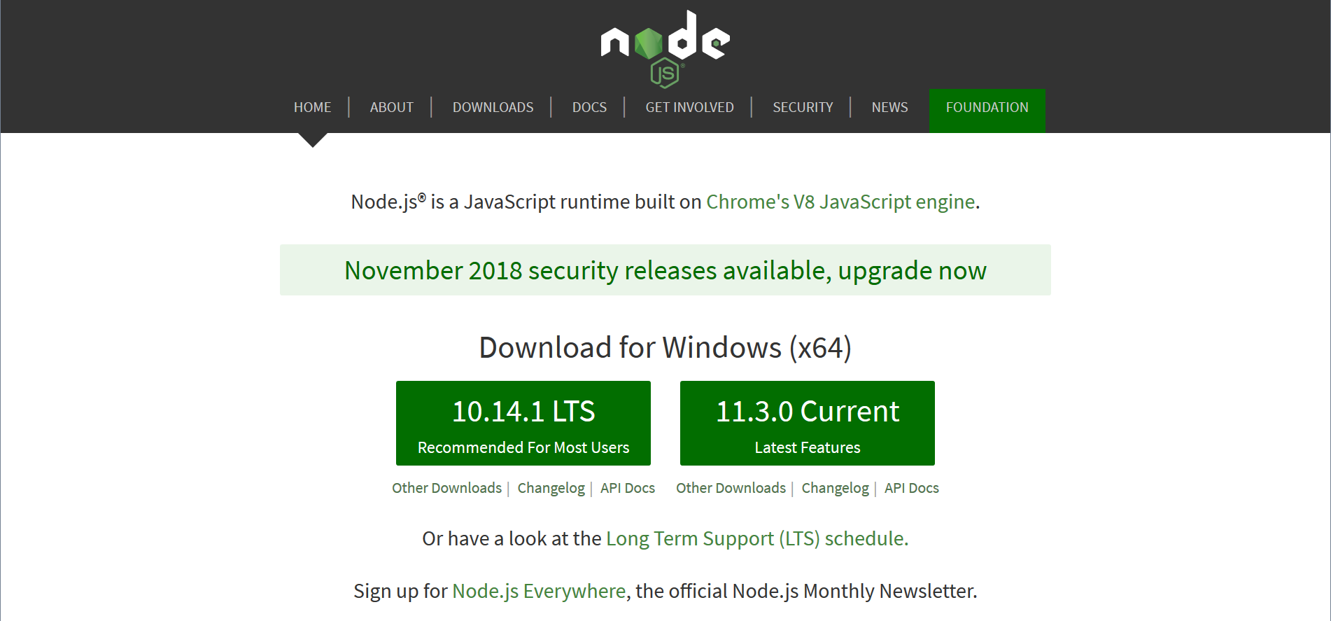
Notes:
Almost nothing in nodejs core libraries uses promises
at this point.
However, they are working on it.

Slide 57
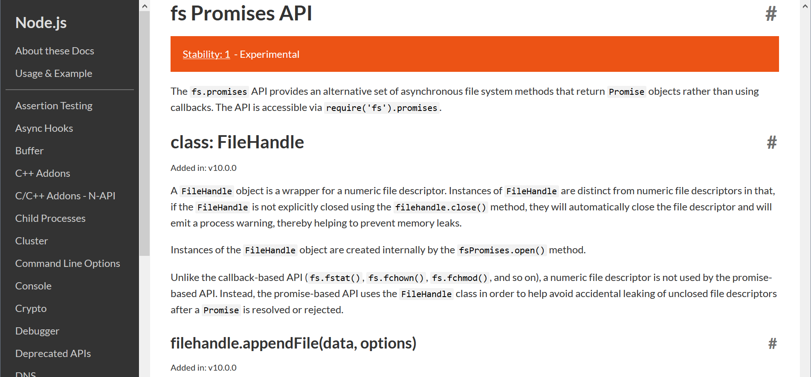
Notes:
Recently nodejs v10 added the fs.promises api.
which give us promise versions of all the FileSystem calls.
And hopefully, more will follow.
Additionally nodejs offers us util.promisify()
to convert nodejs style callbacks

Slide 58
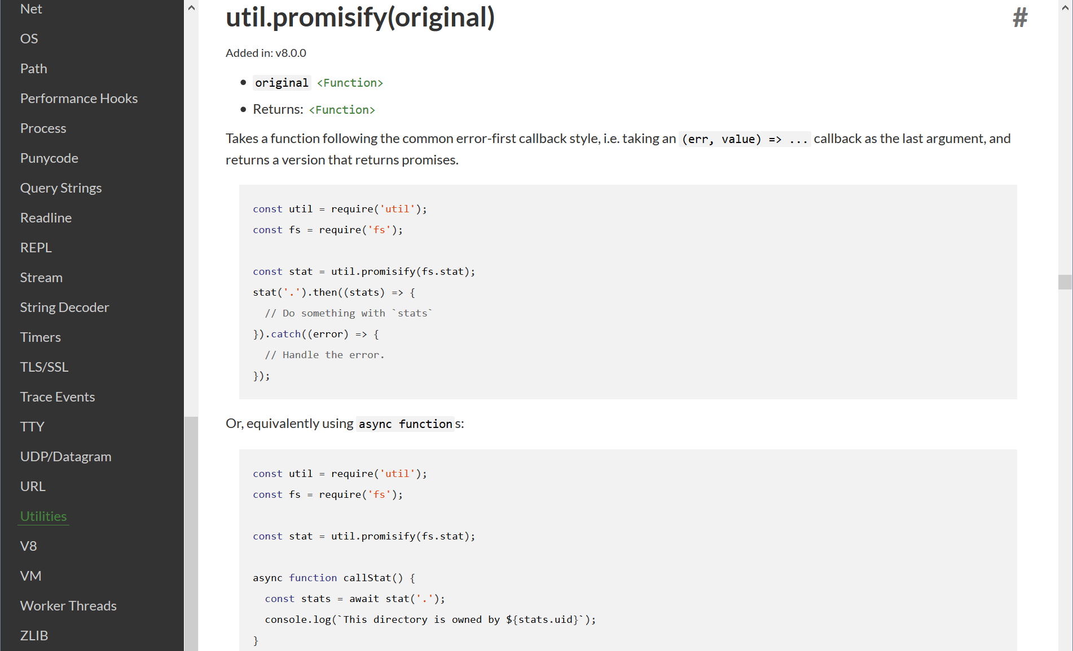
Notes:
Into promise version of the same call.
but you need to be careful with using util.promisify,
Especially around the number of arguments.
In many cases nodejs allows for the same call
to be used with different arguments,
which can make util.promisify() act a little wierd.
Secondly, when we were previously talking about the async keyword
I mentioned that in order to use await, it must be inside an async function.
This means that you cannot use the await keyword in your top-level code.

Slide 59
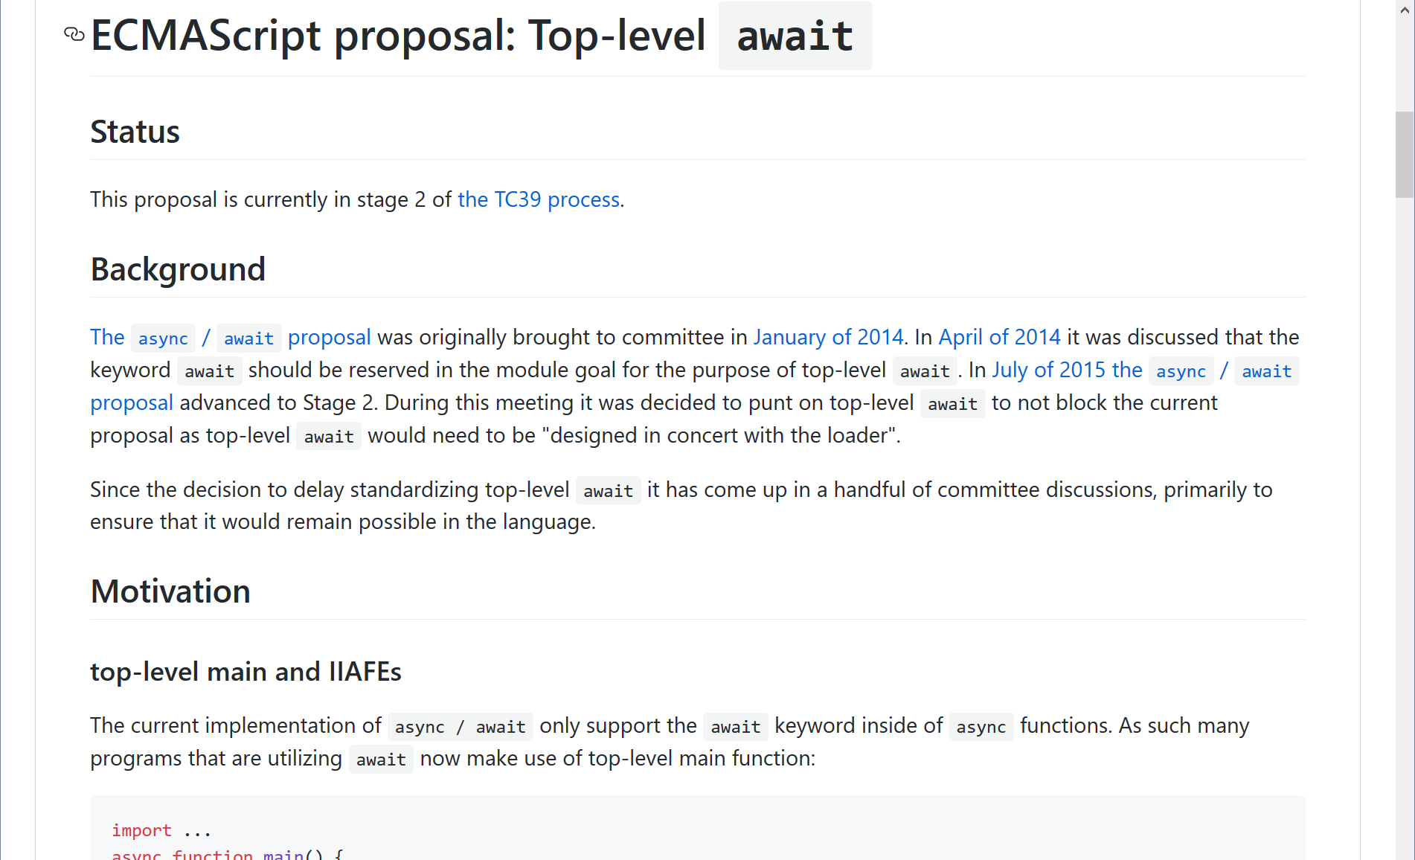
Notes:
However, there is currently a proposal
for supporting top-level await for ES2019.
and there are work arounds
such as using an IIFE or the like.
<PAUSE>
All right that's it.
That's why you should be using async/await in your code.
It’s super simple,
It makes your code more readable,
And it frees us from callback hell and promise purgatory.
So what are you waiting for?
Async/await is supported by all the modern browsers

Slide 60
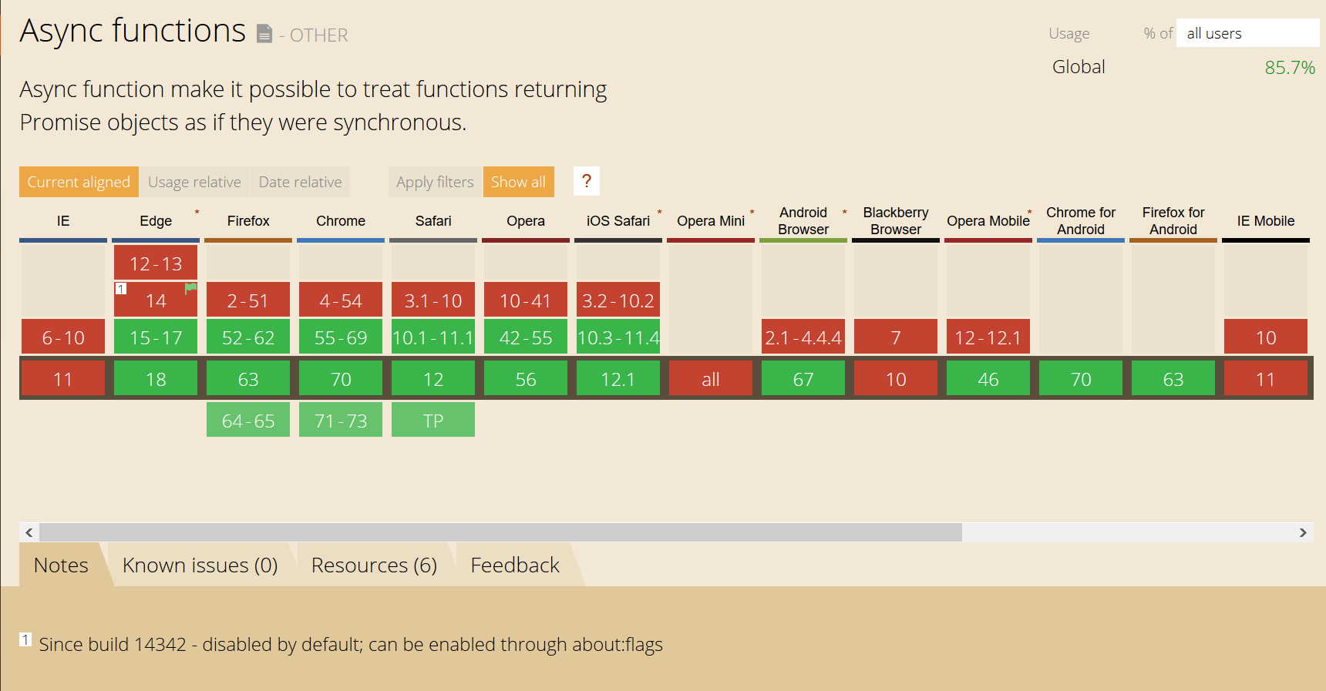
Notes:
as well as nodejs v8 or later.
There are some edge cases but hopefully
internet explorer will die a horrible death soon
and we can finally move on.
And seriously, is blackberry really still a thing?

Slide 61
Why are you “Awaiting”
to use Async!
Notes:
So
stop “Awaiting"
and resolve your feelings
for using async/await...
before the rest of the world
rejects you.
I promise you wont regret it.
If you do you can call me back.
Thanks you for listening.
<NEXT SLIDE>

Slide 62

Glen R. Goodwin
@areinet
arei.net
github.com/arei
Awesome Engineering
github.com/awesomeeng
npmjs.com/org/awesomeeng

